Slide 1
Dual Enrollment as a Predictor of Post-Secondary Behavior
Dylan Antovich
July 28th, 2020

Slide 2

Dual Enrollment
Potential benefits:
College GPA (e.g., An, 2013; Jones, 2013)
College graduation rates (e.g., An & Taylor, 2019; Grubb, Scott, & Good, 2016)
Questions from the State:
Who pursues dual enrollment?
Does dual enrollment predict college enrollment or success?
Dual Enrolled
1 block = 1000 students
HS Only
Notes:
Dual enrollment allows students to receive simultaneous high school and college credit.
There are a number of potential benefits to dual enrollment, given that students are exposed to college-level coursework and are able to take care of lower level courses, it may familiarize students with college and could save them time and tuition
Given this background, the state is considering formalizing its dual enrollment program to provide better access. Before doing this, the state would like to understand the types of students who take advantage of dual enrollment and would like to assess whether dual enrollment is associated with success in college
Overall the state student body is approximately 50% white, with a large African American population (40%) and small populations of Hispanic (5%) and Asian (2%) students
Of the four primary location types (city, suburban, town, or rural), the largest group of students come from rural high schools (40%), followed by cities (30%), then towns (15%) , then suburbs (15%)
The larger city schools have much lower proportion of white students, particularly relative to African American students and much higher proportion of students who are eligible for free and reduced price lunch
The Northwestern (32%); Northeastern (14%), and East Central districts are the most populous

Slide 3
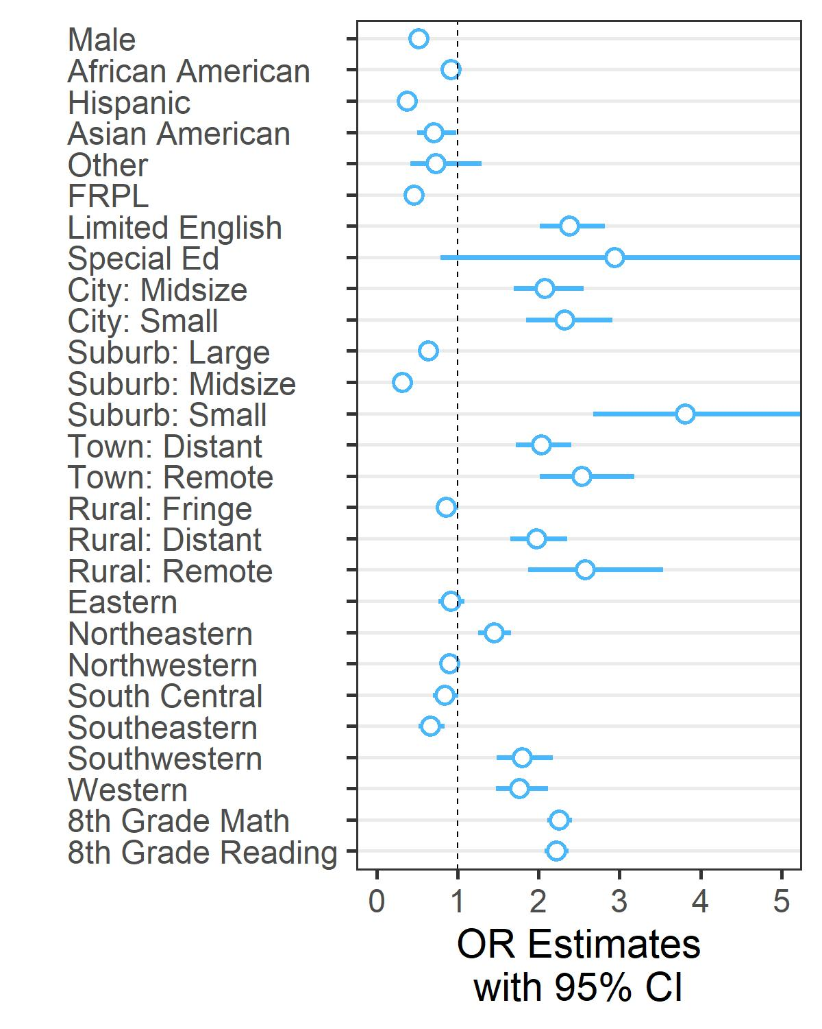
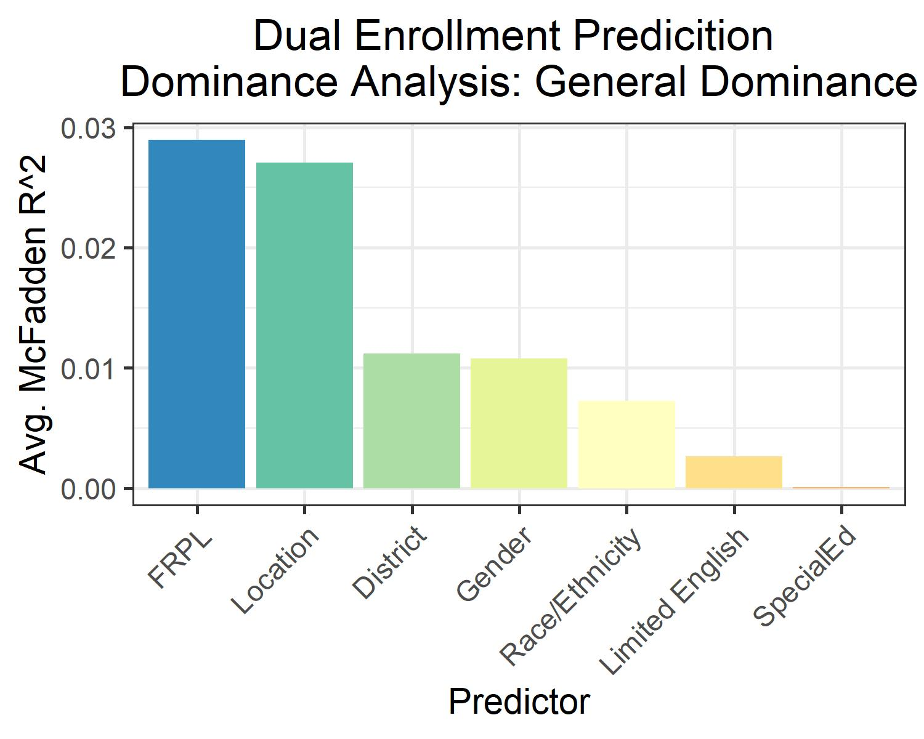
Predictors of Dual Enrollment
Race/Ethnicity
Ref = White, Not Hispanic
HS Location
Ref = Large City
District
Ref = East Central
Predicting Dual Enrollment
Notes:
To initially assess which factors predicted dual enrollment I conducted a large logistic regression that included demographic and testing variables for students and variables related to school and district location
This first plot shows the odd ratios for each level of the categorical variables and the continuous variables
Points that fall to the left of the dashed line indicate reduced likelihood of dual enrollment, whereas dots to the right indicate increased likelihood, with points that are not crossing 1 being statistically significant. There were a number of significant predictors, including gender, race, eligibility for FRPL, test scores, district, geographic location, and limited English (USE LASER POINTER)
We can see that in general, males had reduced odds of participation that female students, minority students had reduced odds of participating in dual enrollment relative to white, non-Hispanic students (particularly students in the Hispanic group), and generally students outside of cities were more likely to engage in dual enrollment
Given the number of significant effects, I chose to conduct a dominance analysis in which the predictive power of each independent variables is assessed across a large number of models with different combinations of predictors. In this case, a students eligibility for free and reduced price lunch was the best of the categorical predictors (with 8th grade reading and math being the most predictive overall) followed closely by location. Although less strong as predictors, district, gender, and race/ethnicity also appear relevant
Anticipated question – why not include random effects for school? It didn’t seem like the school was a level of analysis that was of interest to the state; it was framed as more descriptive, so instead I chose to present results but adjusted the p-values cluster-adjusted SEs.
However, I also ran a model including a random intercept for school and the results of that analysis were very similar, though the effect of location and district were eliminated
Multi-level models are less familiar models to me, so I hope to learn more in the future.

Slide 4
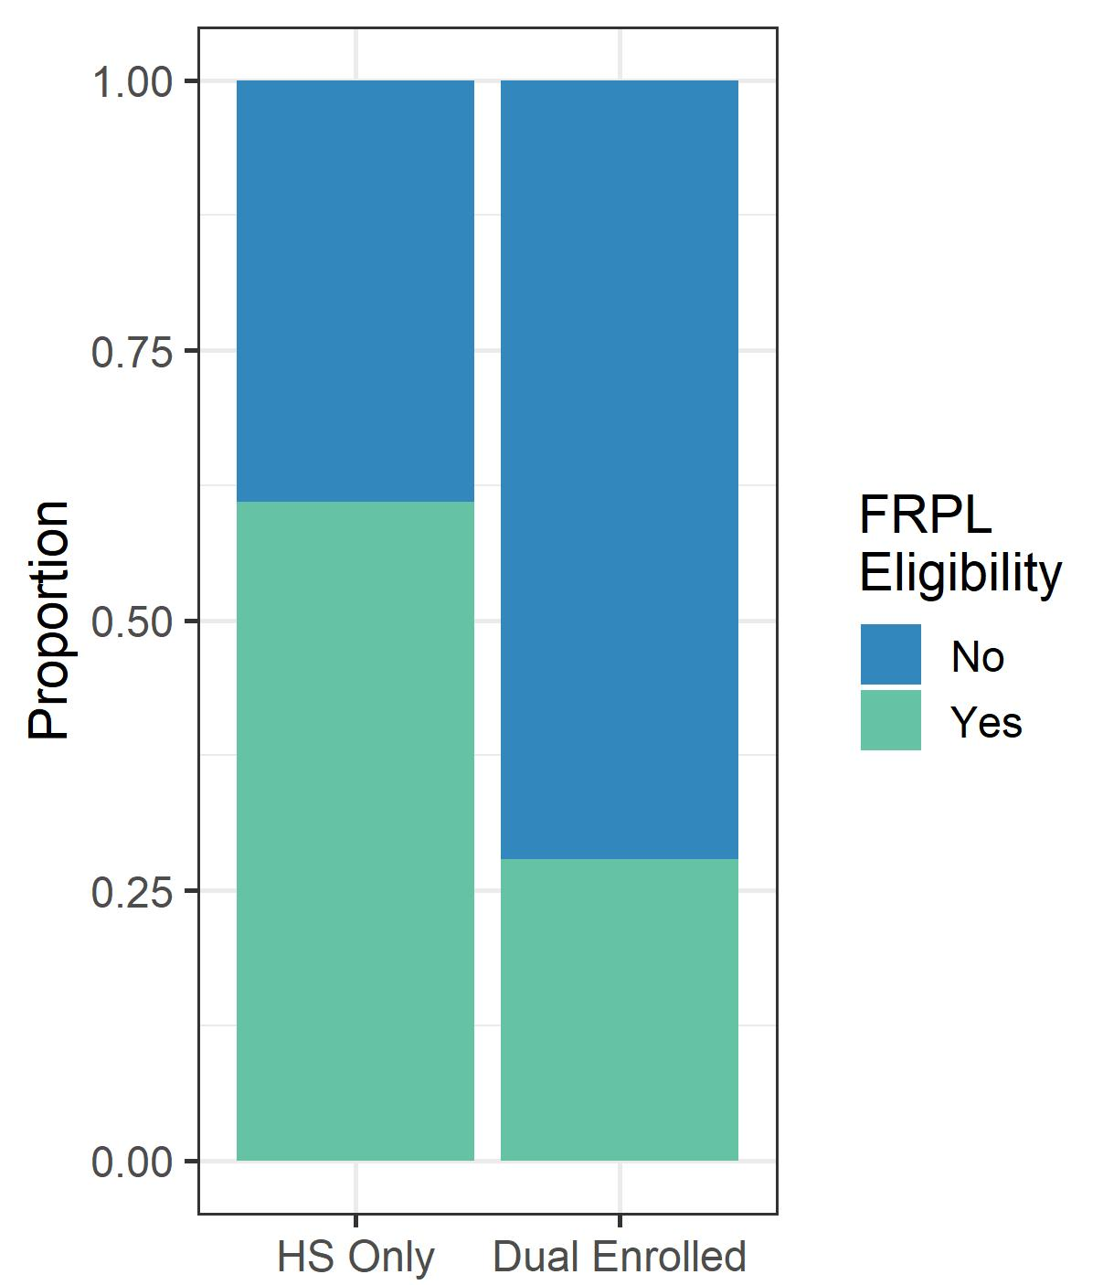
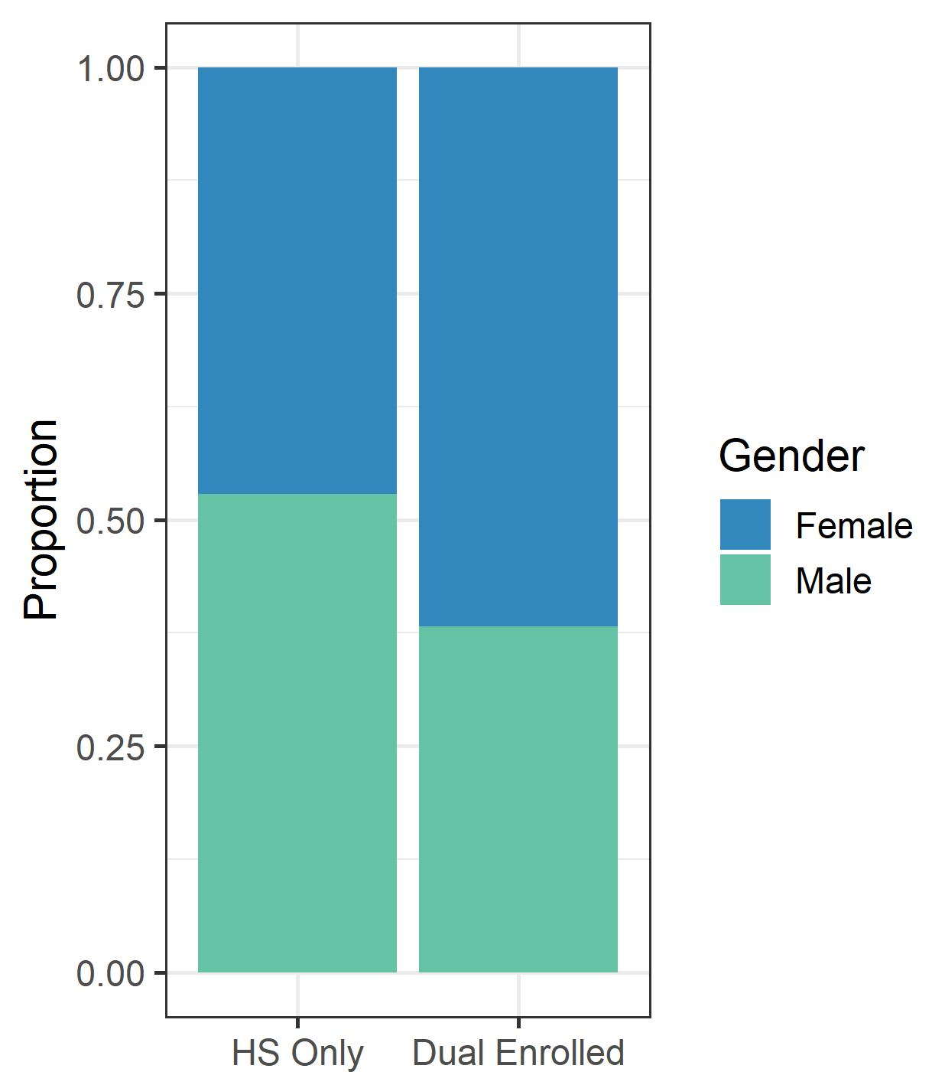
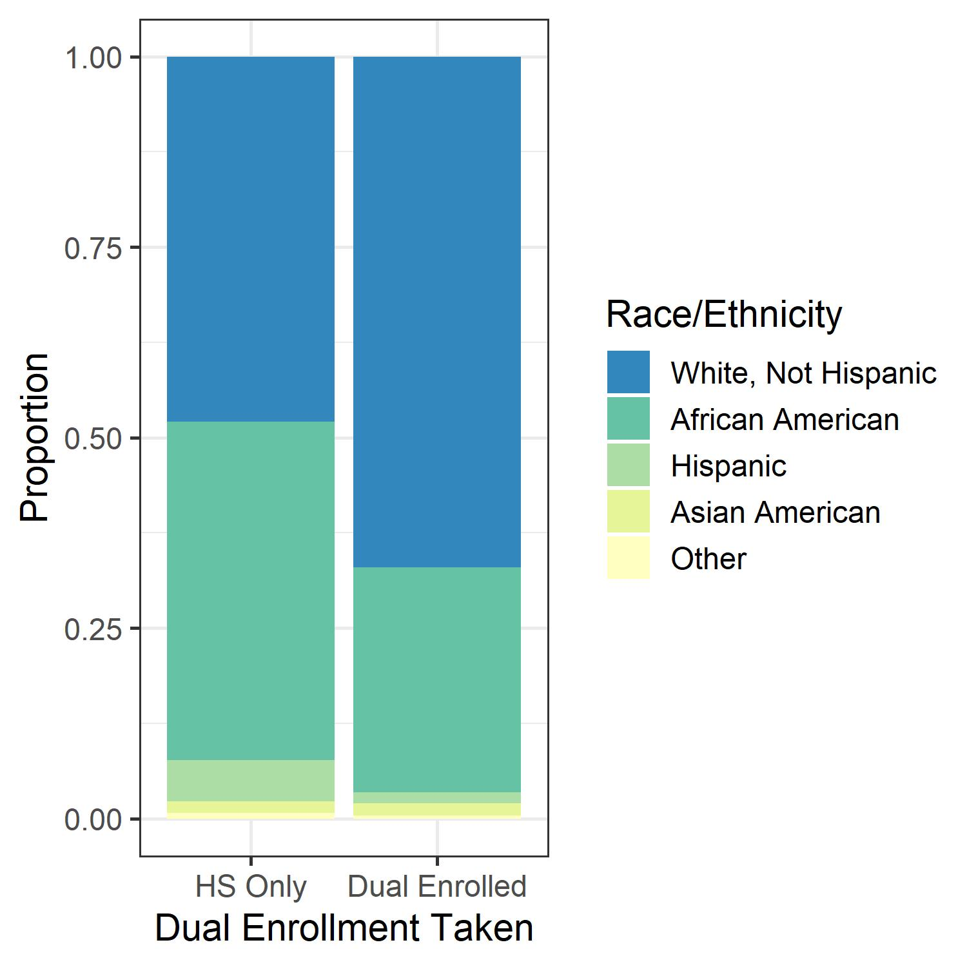
Predictors of Dual Enrollment
Most Predictive Demographic Characteristics
Notes:
These figures confirm that what we saw in the prediction mode was true for the demographic variables
Over on the left we see that students who were dual enrolled were less likely to be FRPL eligible.
Similarly, dual enrolled students were more likely to be white and female than their counterparts who did not engage in dual enrollment

Slide 5
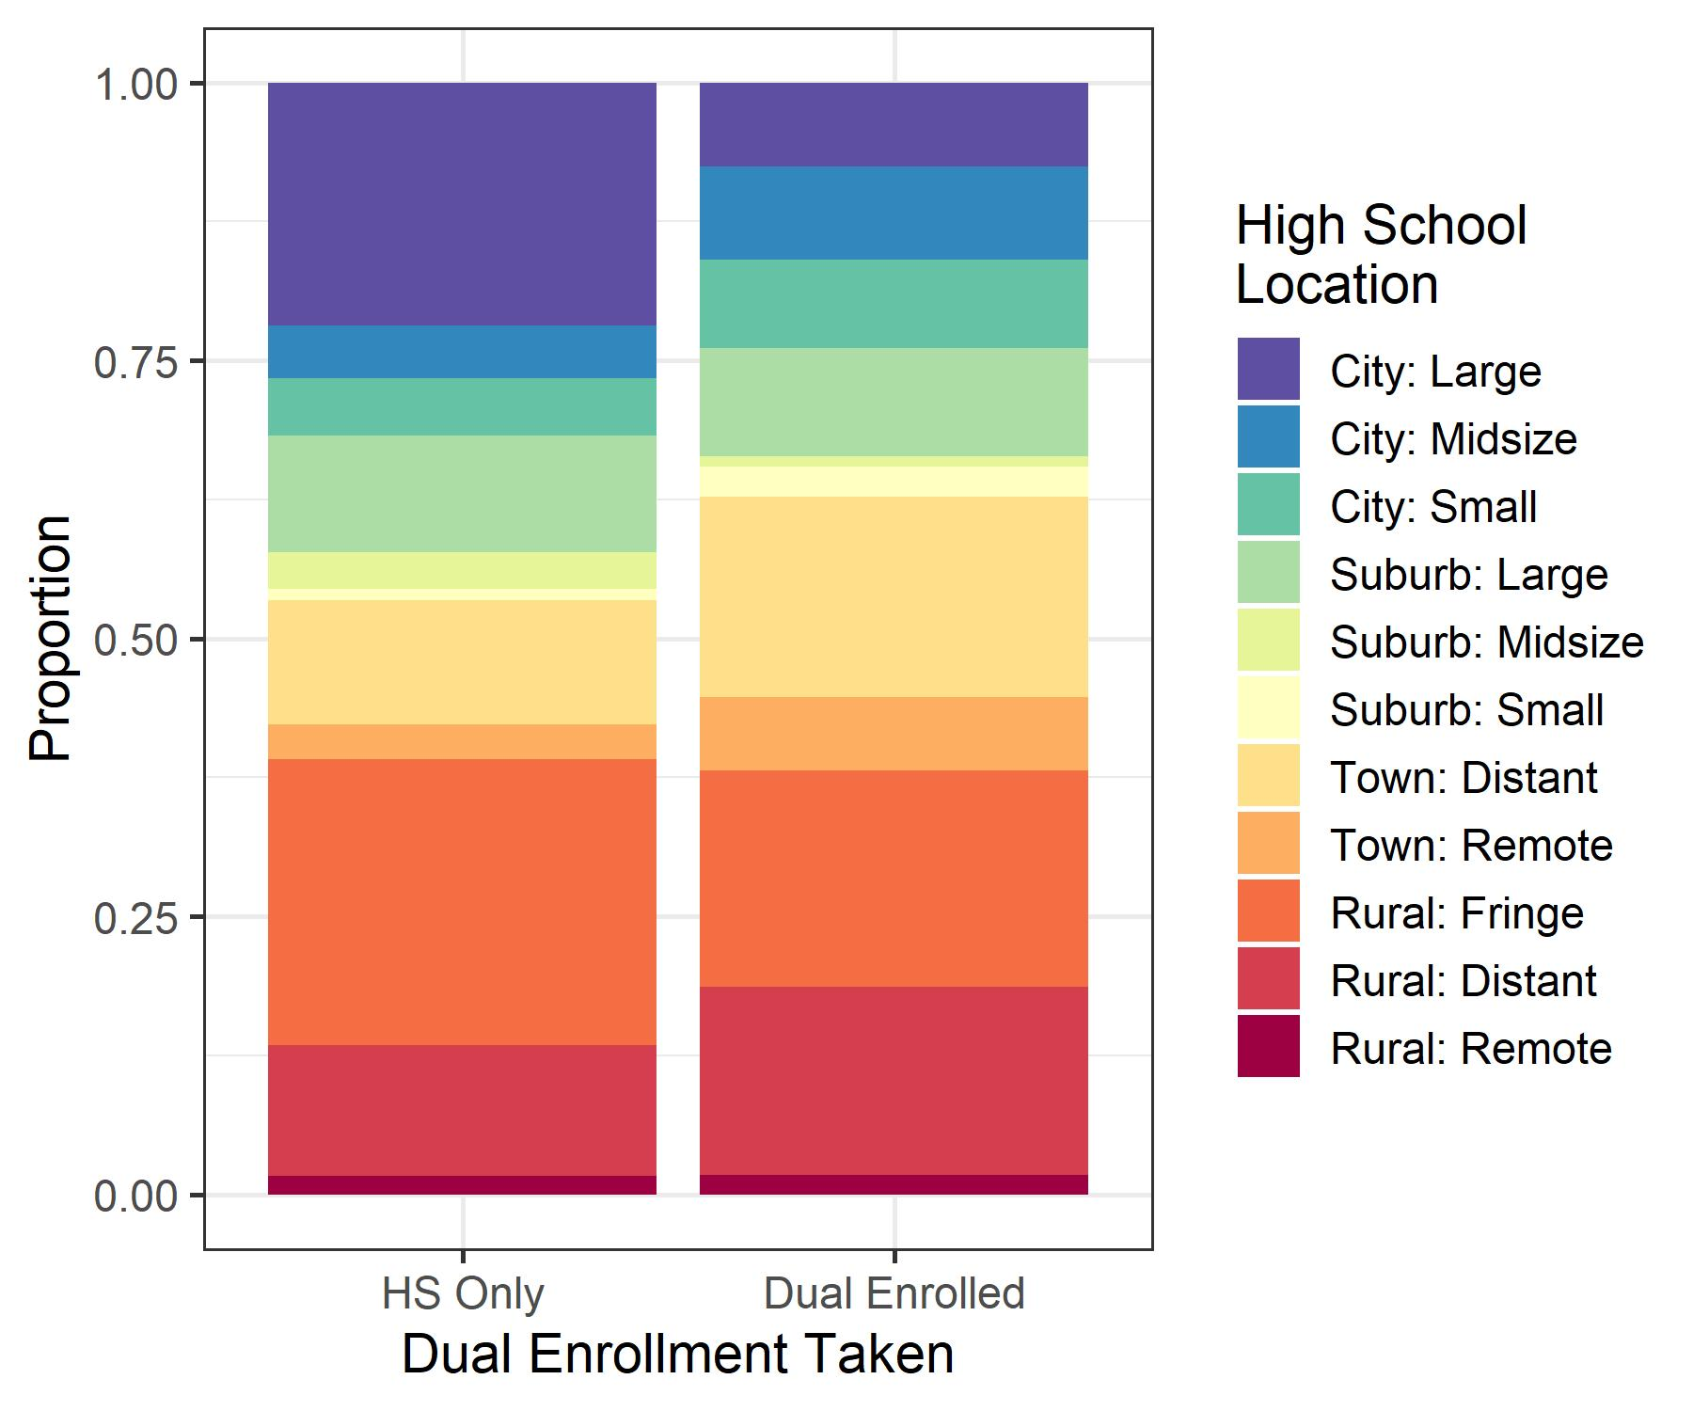
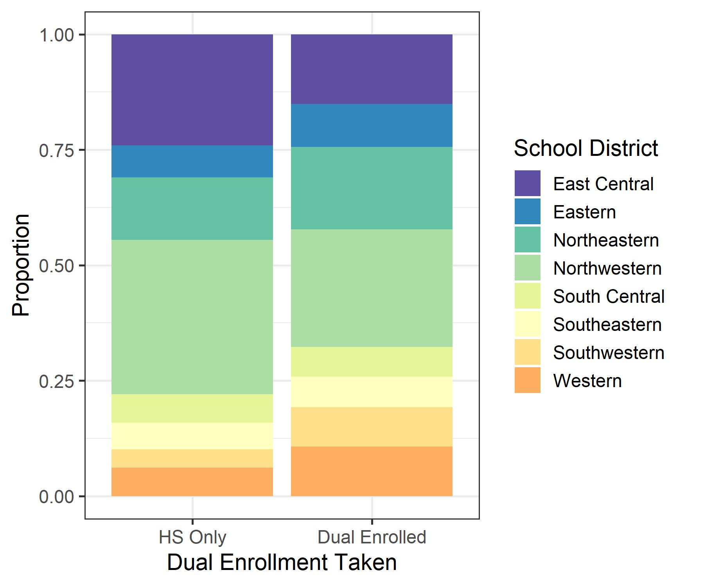
Predictors of Dual Enrollment
Most Predictive School Characteristics
Notes:
Similar to the last slide, this depicts the differences in dual enrollment across different geographic and district areas
These two align, given that the east central and northwestern districts covered all the large cities and were thus less under-represented for dual enrollment, whereas the more rural districts (e.g., eastern, northwestern) have an increased share of the population of students who are dual enrolled.

Slide 6
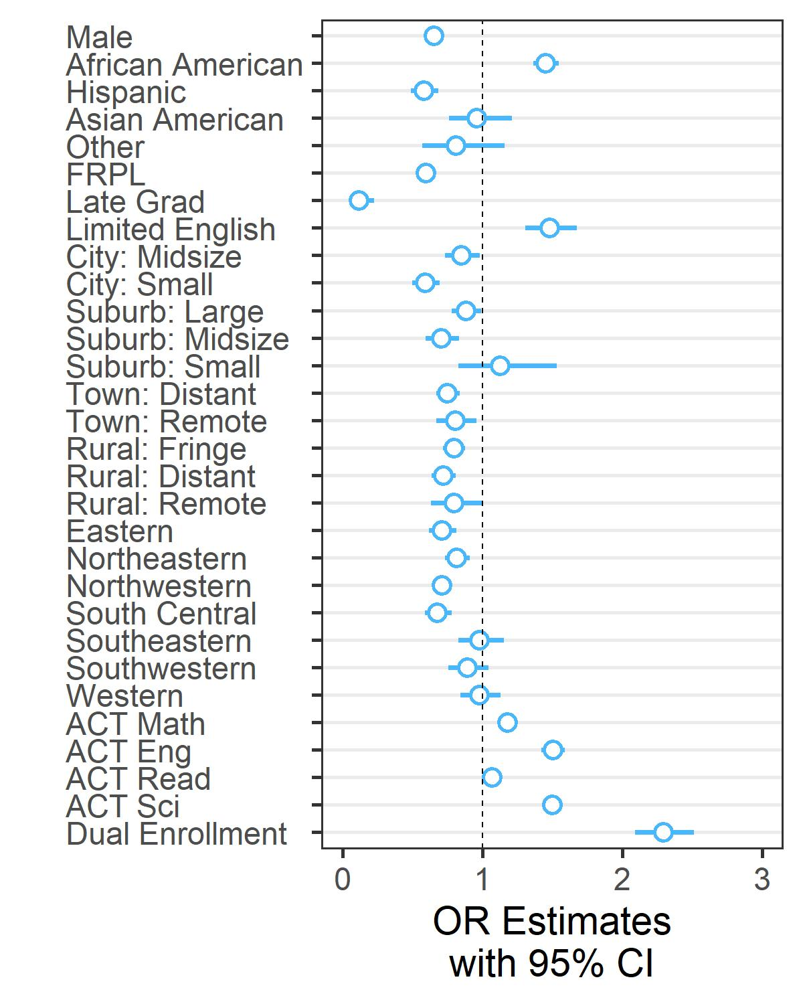
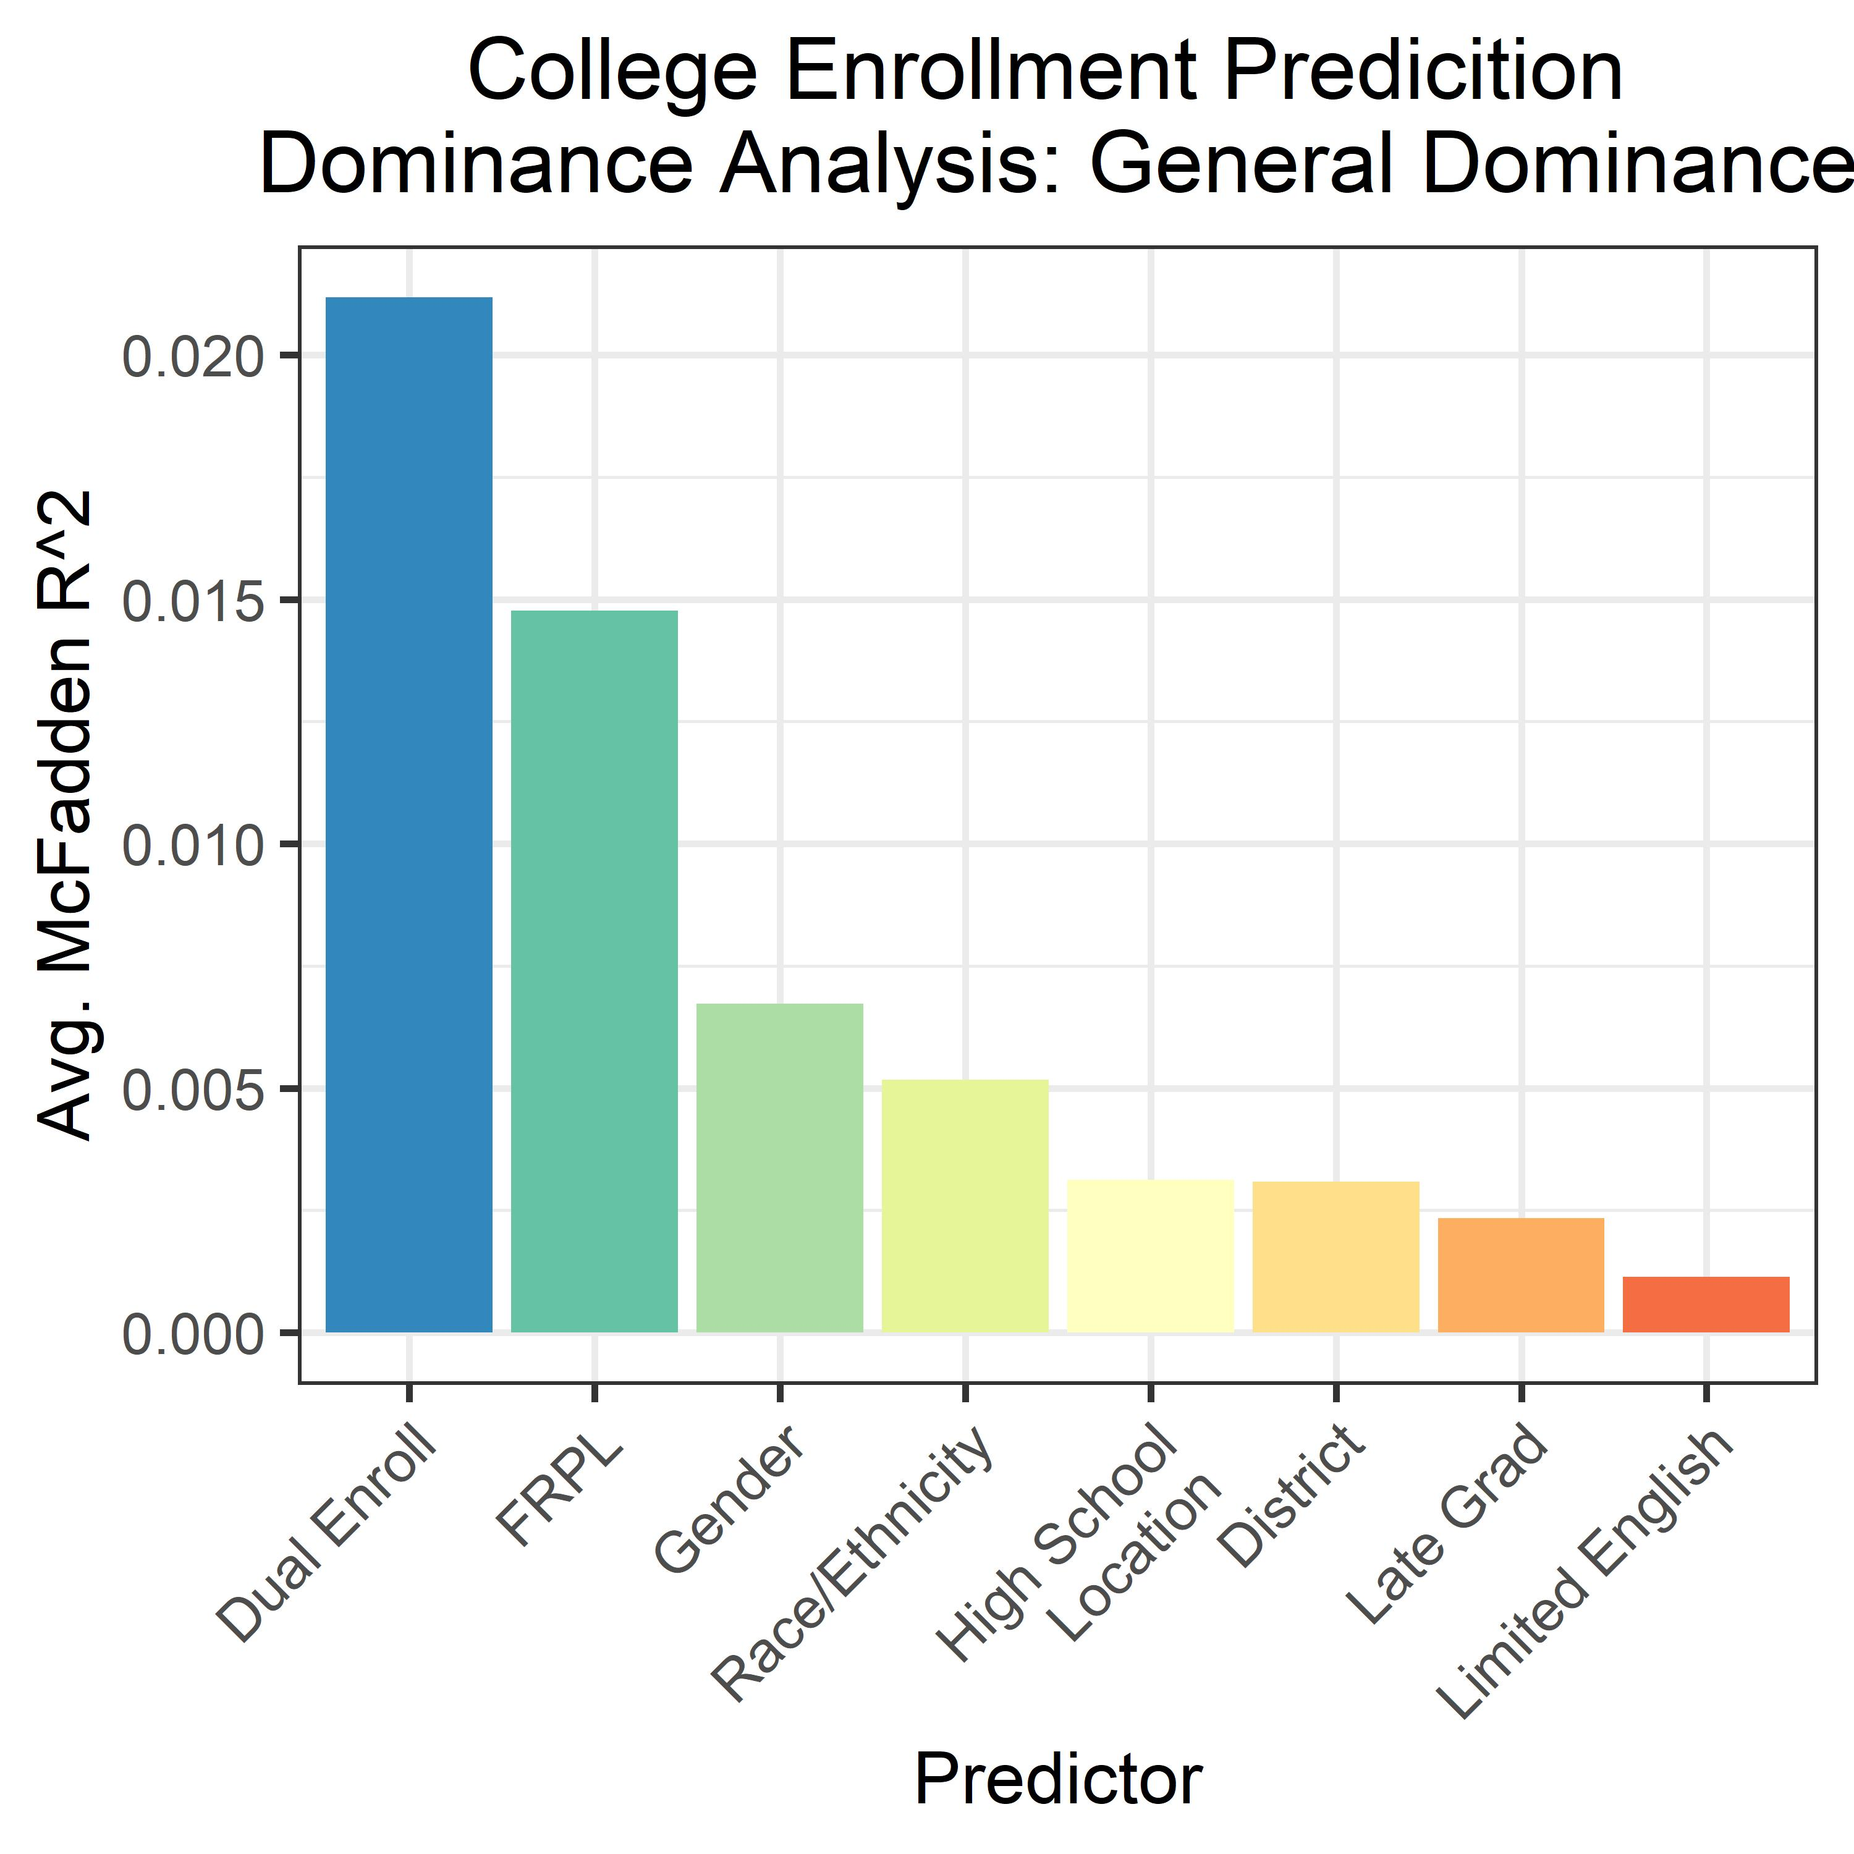
Dual Enrollment & College
Race/Ethnicity
Ref = White, Not Hispanic
HS Location
Ref = Large City
District
Ref = East Central
Predicting College Attendance
Notes:
In order to demonstrate whether dual enrollment was associated with college attendance in the state, I conducted another logistic regression using similar predictor variables, with the exception of adding ACT scores instead of 8th grade scores and removing special ed, as no special ed students in this sample attended college.
However, we can see that the pattern of predictors differs for this analysis in some cases, with geographical predictors appearing less relevant. Males are still less likely than females to attend college, but in this sample,
This suggests that, aside from test scores, dual enrollment was the best predictor
Given that FRPL was also an important predictor, examined interaction between these two, though that was not significant suggesting that the effect of dual enrollment was not contingent on being from a higher SES group
Anticipated question – what is general dominance? General dominance is average across models; conditional dominance show dominance with a given number of other predictors, and total dominance demonstrates better predictive power across all models

Slide 7
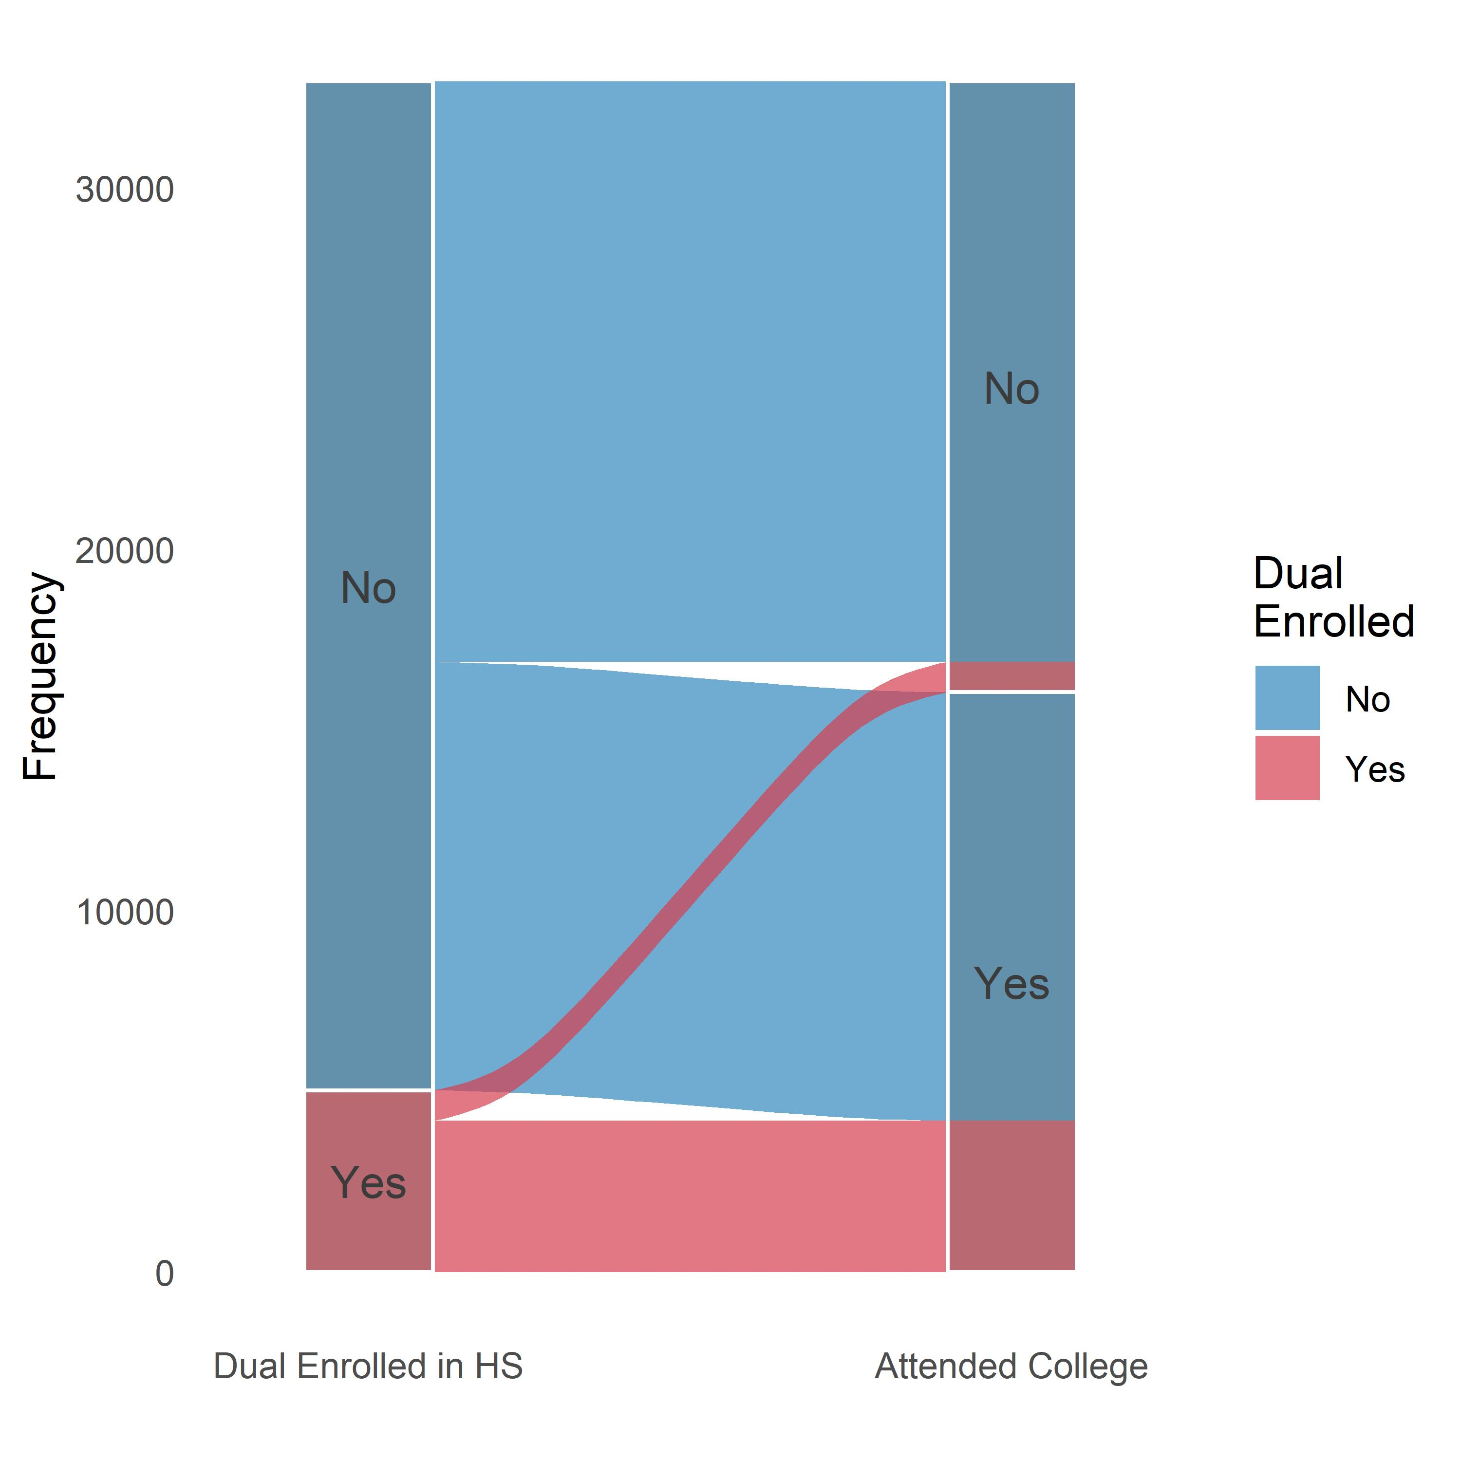
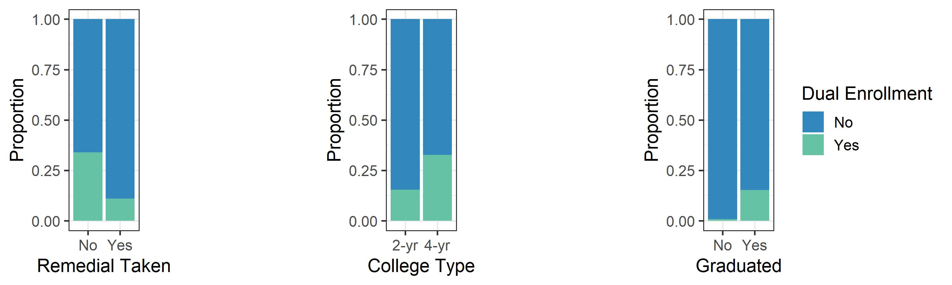
Dual Enrollment & College
Students who were dual enrolled had:
130% greater odds of attending college
50% greater odds of attending a 4-year college
30% lower odds of taking remedial courses
1600% greater odds of graduating high school
Notes:
In a large logistic regression model accounting for demographic variables, college entrance exam scores, and school location…
Just under 2/3 of college students were enrolled in 4-year institutions with the odds of attending a 4-yr college increased those odds by 50%, again suggesting that these students might have been better prepared to enter college
Over 1/3 of students enrolled in public colleges in the state took remedial coursework, the odds of students taking remedial coursework decreased by about 1/3, suggesting that they were more prepared for college, potentially putting them on track to graduate in less time having accrued less debt
While the state’s overall hs graduation rate was just over 80%, 99% of students who were dual enrolled graduated graduated, and a slightly larger proportion of those students also graduated on time, though most students did overall
Anticipated question: Chicken and the egg issue;
Note these effects were generally not predicted by number of hours of dual enrollment coursework

Slide 8
Conclusions
Dual enrollment:
Positive impact on college attendance
Reduces need for remedial coursework
Approx. 12% of students, but not utilized equitably
Particularly for low SES students in large cities
Future analyses should investigate other measures
Predictors
Do first generation college students benefit from dual enrollment?
Does proximity to colleges affect utilization?
Does dual enrollment in online or blended learning contexts influence post-secondary outcomes?
Outcomes
Are dual enrollment students more likely to complete college or accrue less debt?
Does dual enrollment affect students’ GPAs?

Slide 9
Supplemental slides

Slide 10
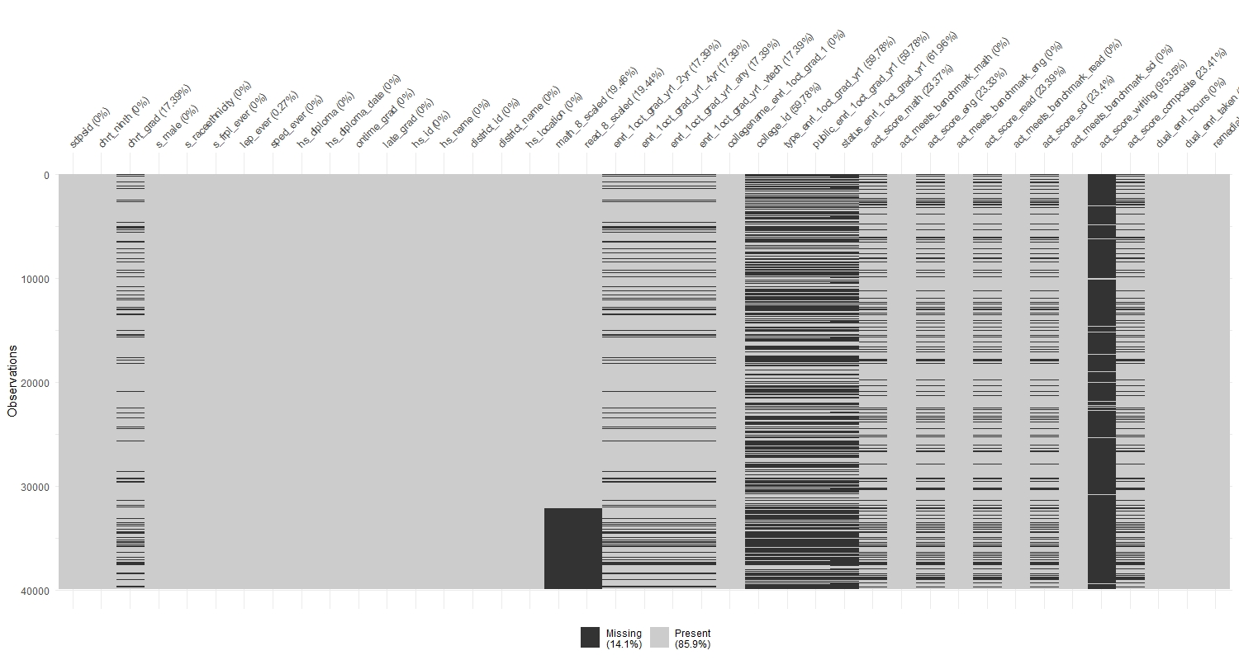
Missingness
Notes:
Might have considered using Multiple Imputation for partial missingness, e.g., 8th grad math scores
Did not invest time in better missing data modelling because it seemed like this task was primarily descriptive, and I wasn’t sure whether districts would be willing to utilize those methods

Slide 11
Model Fit
Dual Enrollment Prediction
MODEL INFO:
Observations: 32018 (7864 missing obs. deleted)
Dependent Variable: dual_enrl_taken
Type: Generalized linear model
Family: binomial
Link function: logit
MODEL FIT:
χ²(27) = 6996.31, p = 0.00
Pseudo-R² (Cragg-Uhler) = 0.36
Pseudo-R² (McFadden) = 0.27
AIC = 18807.85, BIC = 19042.32
Standard errors: MLE

Slide 12
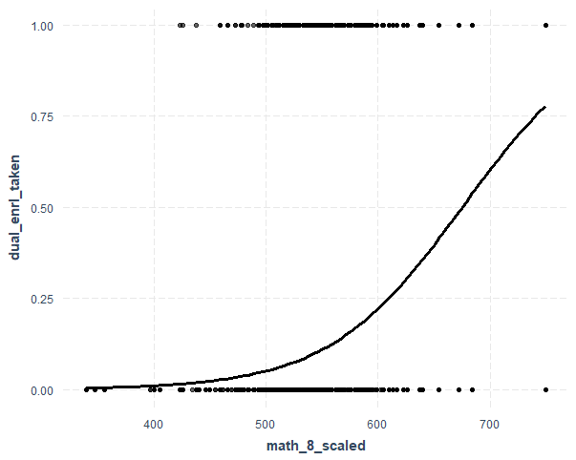
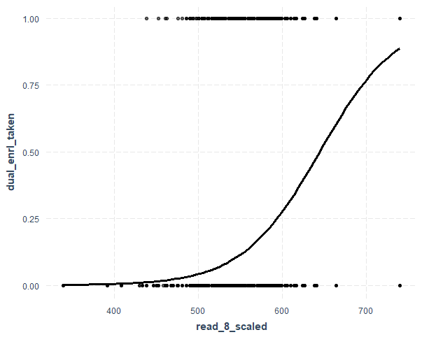
Test Scores Predictions
Math (8th)
Reading (8th)

Slide 13
Test Scores Predictions

